Slide 1
AWS VPC (VPC ENDPOINT, VPC PEERING, VPC NACL)
03.10.2020
15:00
OSVALDO

Slide 2

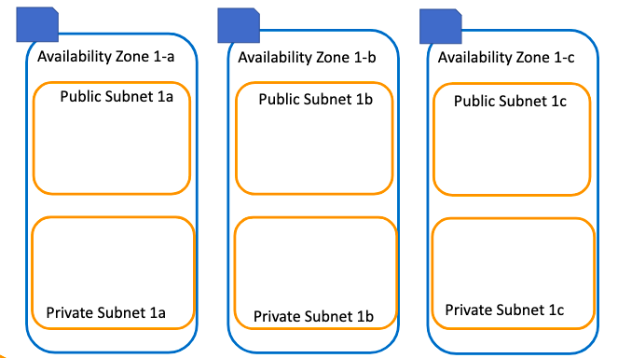
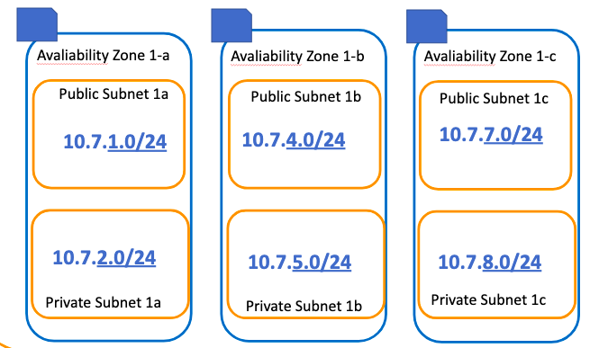
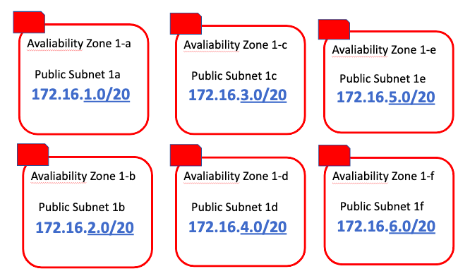
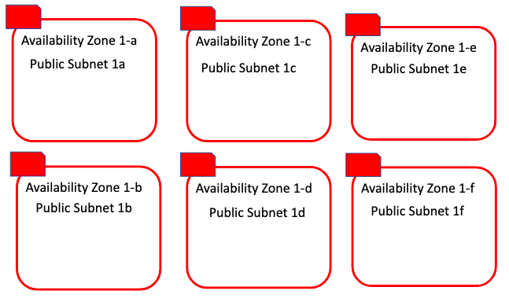




N.Virginia
Internet Gateway
Region : N.Virginia
VPC :clarus-vpc-a
Region : N.Virginia
VPC : Default
NAT Gateway
Bastion H
VPC Peering
Website

Slide 3




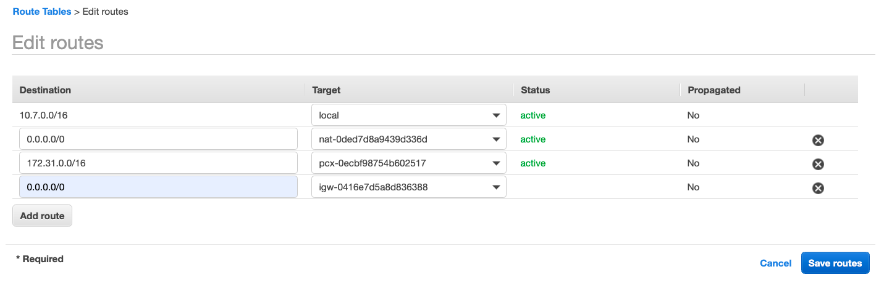

NAT Gateway
VPC Peering
Local
Route
Tables
Internet
Gateway

Slide 4



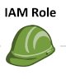
AWS
Region : N.Virginia
VPC :clarus-vpc-a
Internet
Gateway
Bastion H
EndPoint
Private Instance
NAT Gateway

Slide 5



Classic Way
VPC Endpoint
AWS
Internet
Gateway
Internet
Gateway
S3
Public
Subnet
Public
Subnet
EC2
EC2
NAT Gateway
* Endpoint
Private
Subnet
Private Subnet

Slide 6

NAT Gateway
VPC Peering
Local
Route
Tables
Internet
Gateway
VPC Endpoint

Slide 7



Security Group inbound
User
Type | Protocol | Port Range | Source
SSH-22 | TCP(6) | 22 | 0.0.0.0/0
All ICMP-IPv4 | ICMP(1) | ALL | 0.0.0.0/0
EC2
PC IP: xxxxxx
1
1
Connection Request
No | Type-Port
1 | SSH-22
3 | All lCMP-IPv4 -All
Subnet
Network ACL inbound
 | Rule | Type | Protocol | Port Range | Source/ Destination | Allow/ Deny
 | 100 | SSH-22 | TCP(6) | 22 | 0.0.0.0/0 | ALLOW
 | 200 | All ICMP-IPv4 | ICMP(1) | ALL | 0.0.0.0/0 | DENY
 | * | ALL Traffic | ALL | ALL | 0.0.0.0/0 | DENY
1 1
1

Slide 8
Security Group inbound
User
Type | Protocol | Port Range | Source
SSH-22 | TCP(6) | 22 | 0.0.0.0/0
All ICMP-IPv4 | ICMP(1) | ALL | 0.0.0.0/0
EC2
PC IP: xxxxxx
Connection Request
No | Type-Port
1 | SSH-22
3 | All lCMP-IPv4 -All
Subnet
Network ACL inbound
 | Rule | Type | Protocol | Port Range | Source/ Destination | Allow/ Deny
 | 100 | SSH-22 | TCP(6) | 22 | 0.0.0.0/0 | ALLOW
 | 200 | All ICMP-IPv4 | ICMP(1) | ALL | 0.0.0.0/0 | DENY
 | * | ALL Traffic | ALL | ALL | 0.0.0.0/0 | DENY
2
1 2

Slide 9
Security Group inbound
(Statefull)
Type | Protocol | Port Range | Source
SSH-22 | TCP(6) | 22 | 0.0.0.0/0
All ICMP-IPv4 | ICMP(1) | ALL | 0.0.0.0/0
ALLOW Only
Network ACL inbound
(Stateless)
Network ACL outbound
(Stateless)
 | Rule | Type | Protocol | Port Range | Source/ Destination | Allow/ Deny
 | 100 | SSH-22 | TCP(6) | 22 | 0.0.0.0/0 | ALLOW
 | 200 | All ICMP-IPv4 | ICMP(1) | ALL | 0.0.0.0/0 | ALLOW
 | * | ALL Traffic | ALL | ALL | 0.0.0.0/0 | DENY
Rule | Type | Protocol | Port Range | Destination | Allow/ Deny
100 | *Custom TCP | TCP(6) | *32768 - 65535 | 0.0.0.0/0 | ALLOW
200 | All ICMP-IPv4 | ICMP(1) | ALL | 0.0.0.0/0 | *ALLOW
* | ALL Traffic | ALL | ALL | 0.0.0.0/0 | DENY

